Slide 1
Introduction to Data Mining
MSCI:6070 Data Science
Data Mining Basics
CRISP-DM
Data Exploration & Visualization

Slide 2
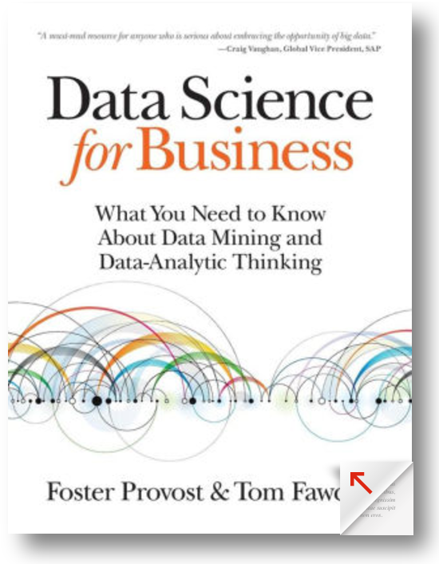
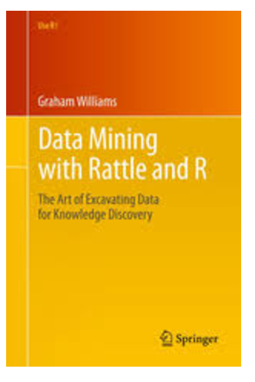
Course Material
Texts:
Data Science for Business: What you need to know about data mining and data-analytic thinking, F. Provost and T. Fawcett. O'Reilly, 2013. —“DSB”
Data Mining with Rattle and R: The Art of Excavating Data for Knowledge Discovery, G. Williams. Springer, 2011. — “DMRR”
Software:
R via RStudio using Rattle package

Slide 3
Grading Scheme
Homework - 24%
4 homework assignments (each worth ~6%)
Discussions allowed, but the final submission needs to be written independently. Identical homework submissions will be considered evidence of academic dishonesty and prosecuted as such.
Exam I - 35%
June 12
In class, computer-based, class materials can be used, internet access not allowed
Exam II - 35%
In class, computer-based, class materials can be used, internet access not allowed
Class participation - 6%

Slide 4
Goals
A basic understanding of business prediction and model selection process.
Theoretical appreciation for a variety of data mining methods.
Practical knowledge of the uses and limitations of data-mining.
Experience making and assessing predictions using a software package.
The ability to compare and select the best model using a variety of metrics.
Notes:
how to formulate a business problem into a mathematical problem
how to solve the problem
how to implement it
Testable explanations as it relates to data. Do you set up experiment/scientific method
Automation in Data Science
Gain knowledge to understand problem and go find the data to solve the problem
Data storytelling

Slide 5
Part I Overview
What is data mining?
Types of problems in data mining

Slide 6
Data
Facebook - 1.65 billion monthly active users
Gmail - 1 billion users
Skype - 300 million users
Twitter - 310 million monthly active users
WhatsApp - 1 billion users
YouTube - 1 billion users, 4 billion daily views
Instagram - 500 million users
Sources: http://expandedramblings.com/index.php/resource-how-many-people-use-the-top-social-media/

Slide 7
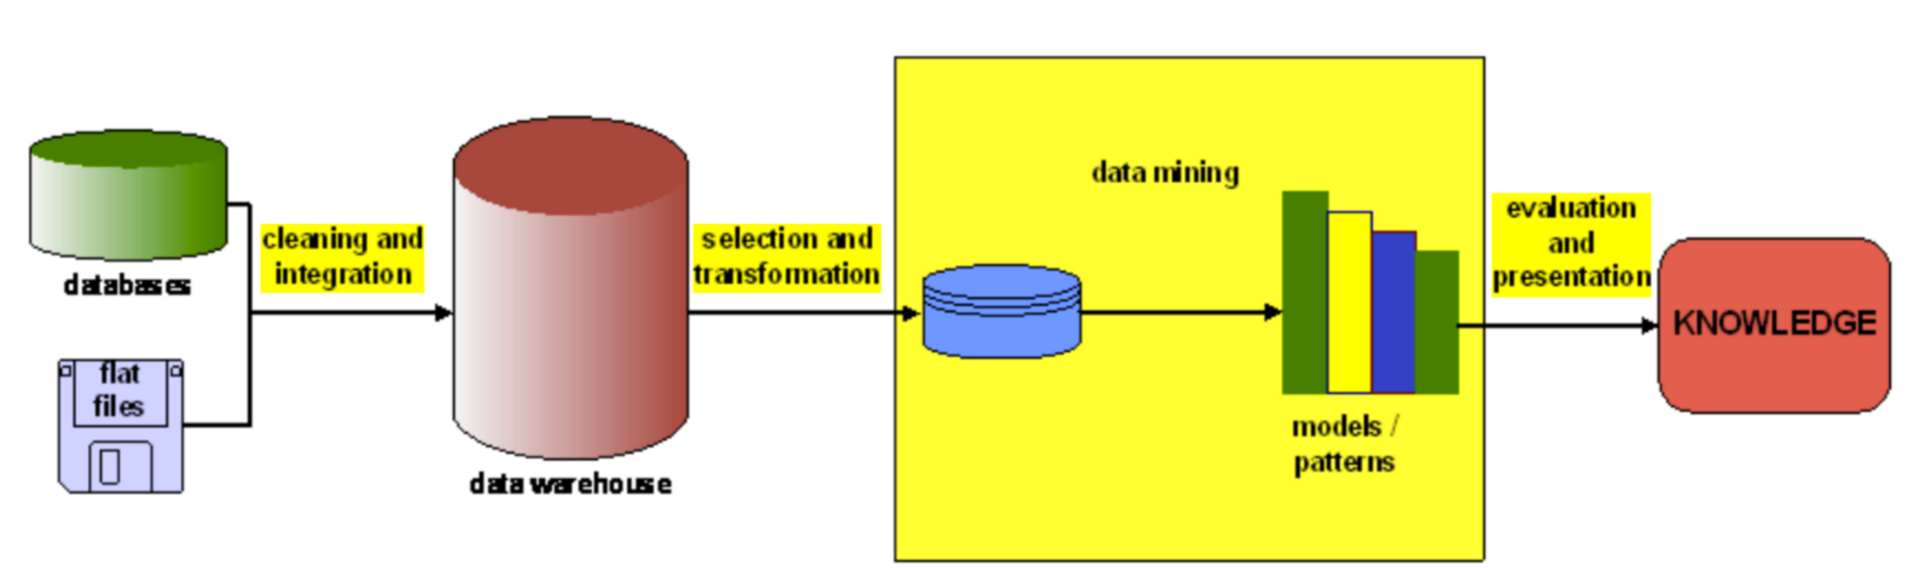
What is Data Mining
Using mathematical techniques
in order to make decisions
Notes:
The precise boundaries of the data mining part within the KDD process are not easy to state

Slide 8
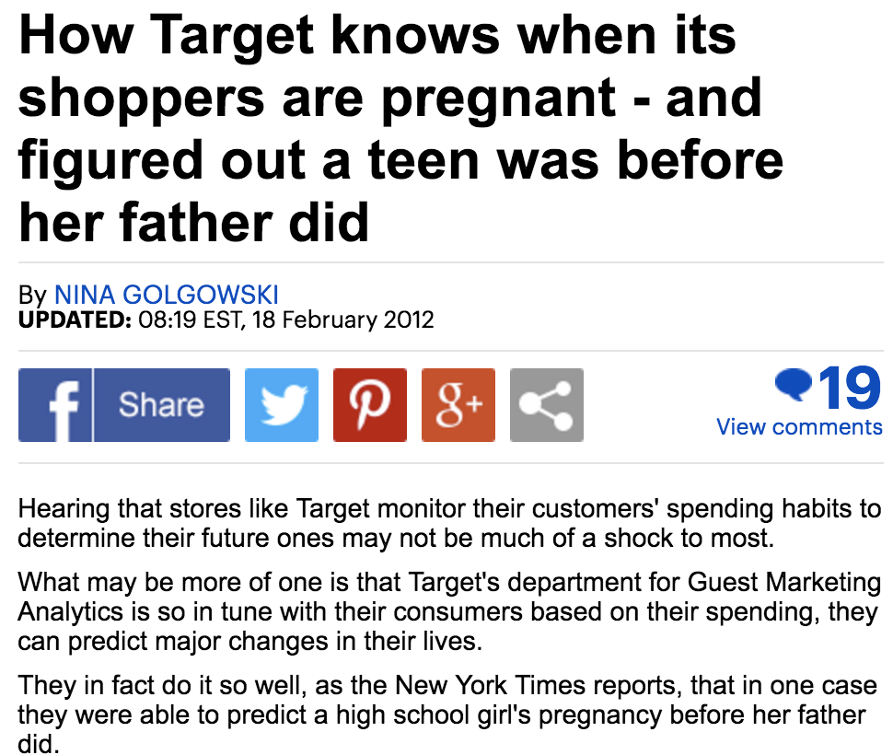

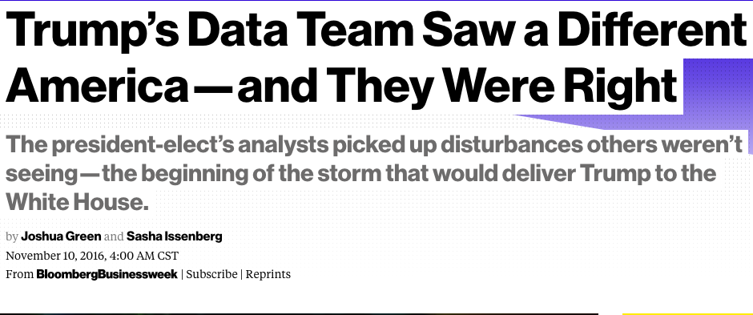

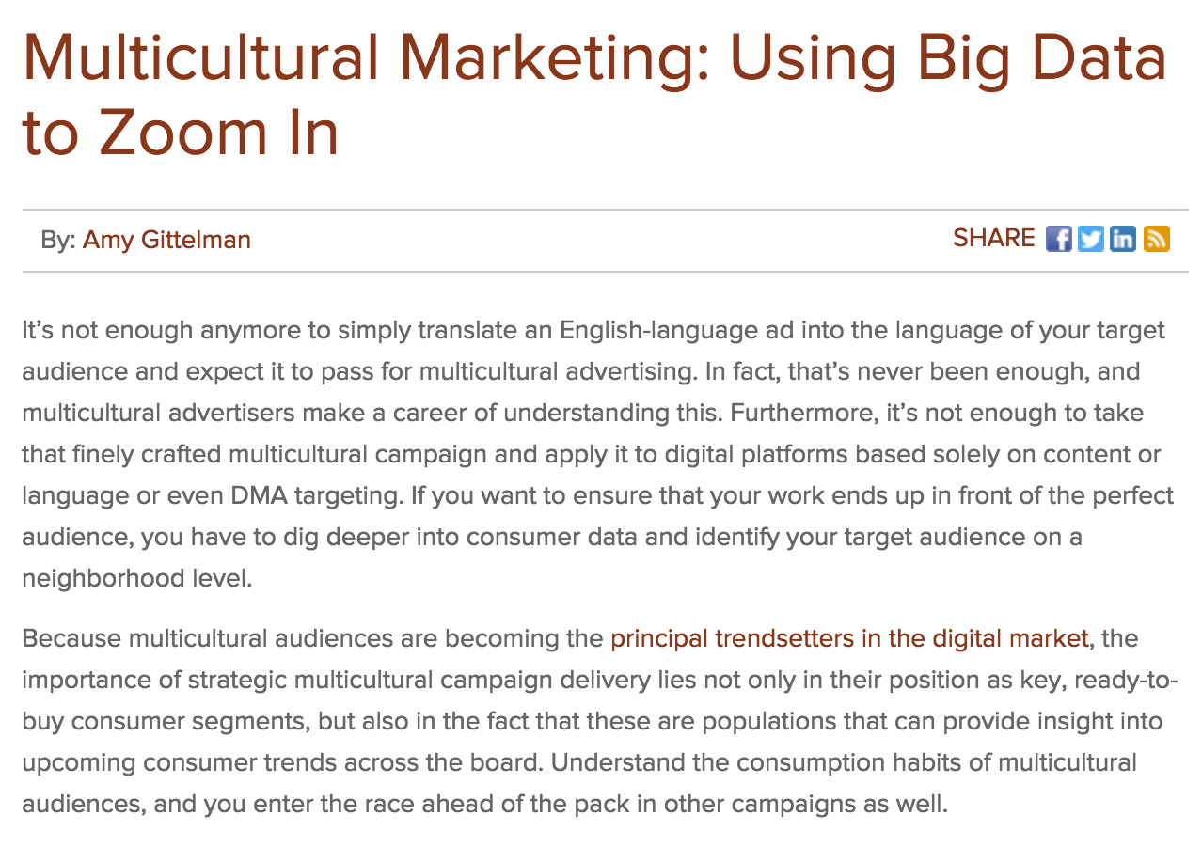
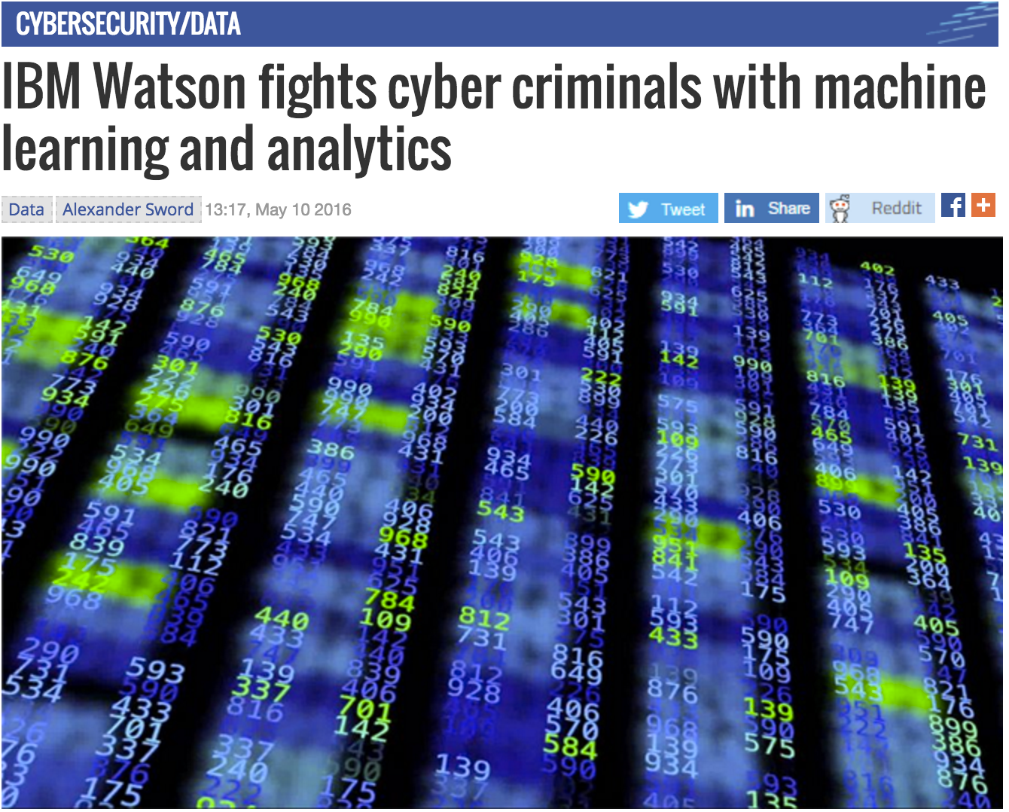
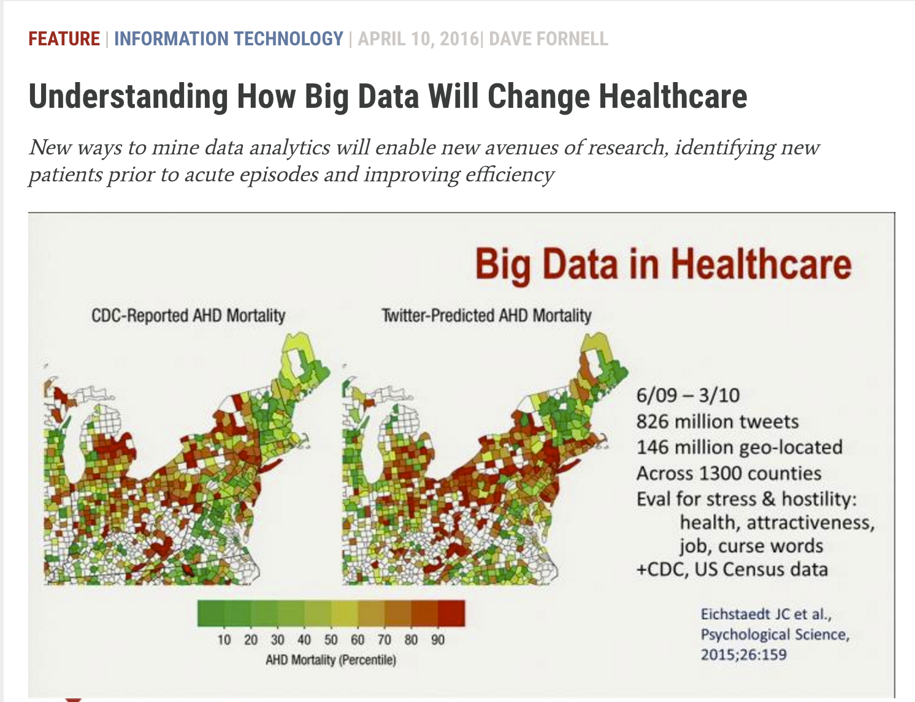
retailing
More
political
science
data mining
marketing
criminology
healthcare
Notes:
Retailing: Every time you go shopping, you share intimate details about your consumption patterns with retailers. And many of those retailers are studying those details to figure out what you like, what you need, and which coupons are most likely to make you happy.
Lots of people buy lotion, but one of Pole’s colleagues noticed that women on the baby registry were buying larger quantities of unscented lotion around the beginning of their second trimester. Another analyst noted that sometime in the first 20 weeks, pregnant women loaded up on supplements like calcium, magnesium and zinc. Many shoppers purchase soap and cotton balls, but when someone suddenly starts buying lots of scent-free soap and extra-big bags of cotton balls, in addition to hand sanitizers and washcloths, it signals they could be getting close to their delivery date. he could also estimate her due date to within a small window, so Target could send coupons timed to very specific stages of her pregnancy.
Political Science: data mining to influence voters and affect the course of the presidential election. Data mining can target individuals and tailor political advertisements to show voters what they’ll most likely want to hear about. For example, a woman with children who has voted Republican in the past will most likely have different political interests than a retired man who doesn’t have children and has rarely voted, according to Meta Brown, data analytics consultant. “Perhaps the mother would hear the candidate’s position on school funding, while the retiree would hear about Medicare,” The Democratic Clinton campaign uses data analytics to develop messages, raise money, and decide what markets to buy ads in and where to place staff.
Healthcare: It uses data and analytics to identify best practices that improve care and reduce costs.

Slide 9
Data Mining Tasks
Each data-driven business decision-making problem can be decomposed of a set of subtasks, some of them are unique to the problem, and some of them fall into a set of well-defined common problems
Fortunately, there are only a handful of fundamentally different types of problems.
Notes:
Some of these subtasks are unique to the particular business problem, but others are common data mining tasks.
A critical skill in data science is the ability to decompose a data-analytics problem into pieces such that each piece matches a known task for which tools are available. Recognizing familiar problems and their solutions avoids wasting time and resources reinventing the wheel.
Despite the large number of specific data mining algorithms, there are only a handful of fundamentally different types of tasks these algorithms address

Slide 10
Types of Problems
Classification (most of the time binary = yes/no)
Regression (predict a value/number i.e. credit score)
Similarity matching
Clustering (grouping similar data points but need to decide what attributes to use)
Co-occurrence grouping (association rules-you bought this, you may like this)
Profiling
Link prediction
Data reduction (reducing variables)
Causal modeling

Slide 11
Overview
What is data mining?
Types of problems in data mining
Data mining Model

Slide 12



Types of Problems
Classification
For each individual in a population, predict a categorical class label for some target
Usually comes with probability estimation or score
Examples
Employee Turnover
Positive or Negative?
Notes:
A few choices

Slide 13



Types of Problems
Regression
Value estimation
For each individual in a population, predict a numerical value for some target
Examples
Examples
Price of a house
Sales forecast
Risk Analysis

Slide 14

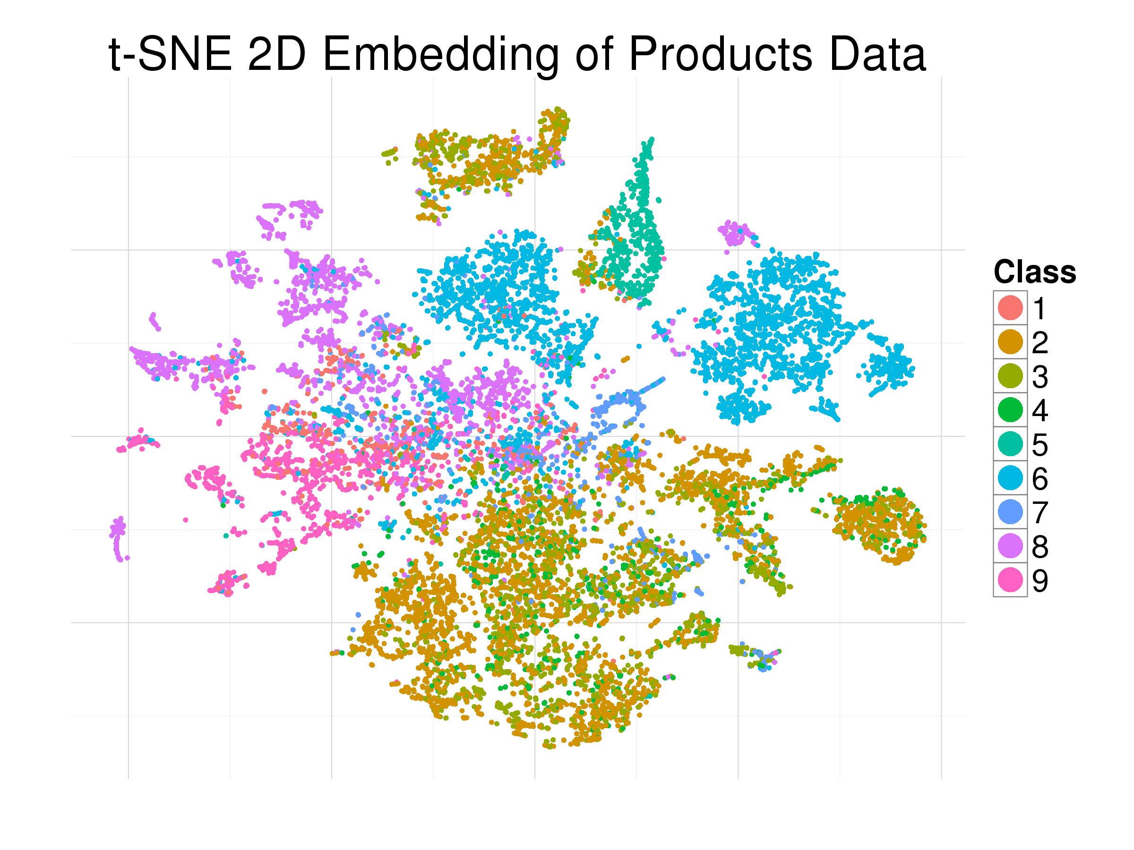
Types of Problems
Clustering
To group individuals together by their similarity, so that individuals in the same group (cluster) are more similar (in some sense or another) to each other than to those in other groups(clusters)
Examples
Consumer clustering
Product clustering

Slide 15
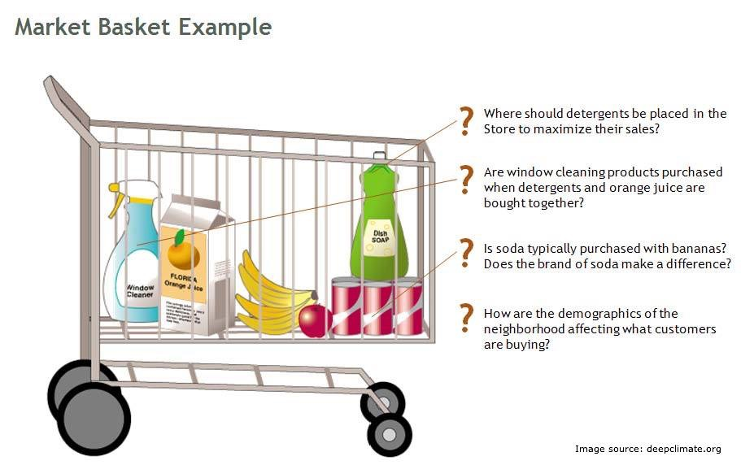


Types of Problems
Co-occurrence Grouping
Also known as frequent items mining, association rule discovery, and market-basket analysis
To find associations between entities based on transactions involving them
Examples: product display, product recommendation, Amazon,etc
Notes:
it’s called market-basked because…
what items are commonly purchased together?
people who bought X also bought Y

Slide 16
Types of Problems
Data Reduction
To replace a large set of data with a smaller set of data that contains much of the important information in the large set.
Usually involves loss of information; trade-off

Slide 17
Practice
What types of problems are they?
What is the rent of an apartment next year? (regression)
Will the customer buy the new product? (classification)
Are there any interesting natural groupings of students? (clustering)
Select some informative features from a data set for faster computation (data reduction)
Is it going to rain tomorrow? (classification)
Notes:
Data with correlations needs to be treated carefully (no independent)
i.e. rent over a period of time vs rent next month

Slide 18
Part II Overview
Data Mining Process
Supervised-hold out sets vs Unsupervised
CRISP-DM
Hold out sets
70/15validation/15test first 15 picks the model (comparing model A and B and C) and then second 15 measures how good-guards in over confidence

Slide 19
Data Mining Model
f(X) = Y
How to choose X?
input/features/covariates
output/target/prediction/decision…
Features/Attributes/Variables
Target Variable
Data Class
Dataset
No. | Age | Gender | Income | Balance | Mortgage payment
1 | 32 | F | 25000 | 32000 | Y
2 | 49 | M | 12000 | -3000 | N
3 | 60 | F | 8000 | 1000 | Y
4 | 28 | M | 9000 | 3000 | Y
…. | …. | …. | …. | …. | ….
instance/
record/
observation
Notes:
How to choose X?
Cross sectional data means there is no order on who comes first in the data set. Don’t need to worry about correlation here
If you have time series data, you need to take into account correlation.

Slide 20
Types of Data
Types of data
continuous
categorical/nominal: has two or more categories, but there is no intrinsic ordering to the categories.
ordinal: similar to categorical but there is a clear ordering of the variables.
ID | age | gender | education | …
20431 | 23 | F | Bachelors
13342 | 54 | M | PhD
30192 | 13 | M | Masters
33291 | 44 | F | PhD
…
Notes:
categorical: A categorical variable (sometimes called a nominal variable) is one that has two or more categories, but there is no intrinsic ordering to the categories.
ordinal: (clear ordering) ranked categorical
Ordinal-special case of categorical: bachelors comes before masters

Slide 21
Data type practice
continuous
Number of children (e.g., 0,1,2,etc)
Income (e.g., 200k, 110k, etc)
Income> 50k? (e.g., Y, N)
Level of pain (e.g., 1,2,3, etc)
Occupation (e.g., student, salesman, etc)
Marital status (e.g., married, divorced, etc)
Number of years as a smoker (e.g., 3, 12, etc)
Health condition (e.g., good, poor)
Do you drink? (e.g., Y, N)
Student’s grade (e.g., A,B,etc)
continuous
categorical
ordinal
categorical
categorical
continuous
ordinal
categorical
ordinal
Notes:
Can have a data set with regression and classification (continuous and classification) same data different question

Slide 22
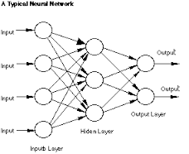
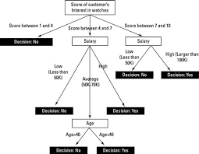
Data Mining Model
Example of a simple model
X1 + 2X2 + 4
X
Y
Input
Output
e.g., age = 44, gender = Female, degree = MS
Model
f(X) = Y

Slide 23
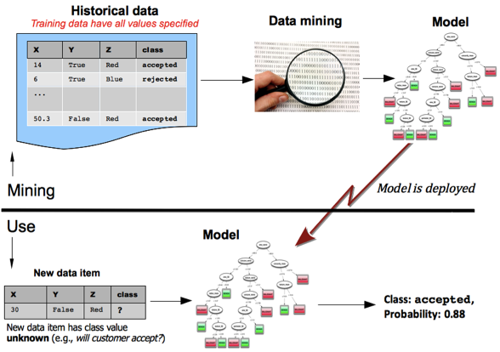
Data Mining Process
1) mining the data to find patterns and build models
2) using the results of data mining
Types of Problems
Classification
Regression
Similarity matching
Clustering
Co-occurence grouping
Profiling
Link prediction
Data reduction
Causal modeling
Types of learning method
Supervised-predictive (how accurate)
Unsupervised-descriptive, no goal-clustering

Slide 24
Overview
Data Mining Process
Supervised vs Unsupervised
CRISP-DM

Slide 25
Supervised and Unsupervised Learning
X
Input
f()
Model
Y
Output
Supervised: training data includes both the input (X) and the result (Y)
Unsupervised: the model is NOT provided with the results (Y) during training
Key Questions:
Is there a specific, quantifiable target/label that we are interested in or trying to predict? (are data available on this target?)

Slide 26
Supervised and Unsupervised Tasks
Task | Unsupervised | Supervised
Classification |  | ✔
Regression |  | ✔
Clustering | ✔
Co-occurrence grouping | ✔
Data reduction | ✔ | ✔
categorical target
numeric target
Examples
Will this customer purchase service 1?
How much will this customer use the service?
Binary classification
Regression

Slide 27
Is there a specific, quantifiable target/output variable?
 | Supervised Learning | Unsupervised Learning
Training data | (Xold, Yold) | (Xold)
Type of Problems | Classification Regression Ranking … | Clustering Frequent Itemset …
Examples | How many cell phone minutes will each customer use next month? Which customers will leave within 90 days of their current contract expiration? Which 10 patients need urgent treatment? Will the customer buy this product? | What are the natural clusters of customers? What are the most popular combinations of items that are bought together in a supermarket?
Notes:
Test talk 7:27
First test is unsupervised learning

Slide 28
Overview
Data Mining Process
Supervised vs Unsupervised
CRISP-DM

Slide 29

Cross Industry Standard Process for Data Mining
CRSIP-DM
Life cycle: 6 phases
Iteration is the rule and the sequence of the phase is not strict.
Why CRISP-DM?
consistency，repeatability，objectiveness
Notes:
-reliable and repeatable by people with little data mining background
Framework for recording experience
Allows projects to be replicated
Aid to project planning and management
Comfort factor for new adopters
Demonstrates maturity of Data Mining
Reduces dependency on “stars”
CRISP is a well-understood process that places a structure on the problem:
- a life cycle of data mining, consists of 6 phases with arrows indicating the dependencies between phases.
- to maintain reasonable consistency, repeatability, and objectivesness.
sequence. In fact, most projects move back and forth between phases.
The diagram makes explicit the fact that iteration is the rule rather than the exception.
Going through the process once without having solved the problem \neq a failure
Often the entire process is an exploration of the data, and after the first iteration the data science team knows much more, then next iteration can be much more well-informed
Let’s now discuss the steps in detail.

Slide 30
Phase 1: Business Understanding
Focuses on
understanding the project objectives and requirements from a business perspective
converting this knowledge into a DM problem definition and a preliminary plan designed to achieve the objectives
Key to success: a successful formulation that casts the business problem as one or more DM problems
Notes:
It is vital to understand the problem to be solved. This may seem obvious, but business problems seldom come pre-packaged as clear and unambiguous data mining problems. Often recasting the problem and designing a solution is an iterative process of discovery. The diagram represents this as cycles within a cycle
What is the problem? What would a solution look like?
In this part, the data slittiest creativity and experience plays a large role…key to success… we have a set of powerful tools (basic tasks discussed) business understanding involves designing a solution that takes advantage of these tools
This phase has to interact with another phase, data understanding; data constraint ( want to cook beef stew, only chicken available)

Slide 31
Phase 2: Data Understanding
Initial data collection
Data are often collected for purposes unrelated to the current business problem. This is very common in most companies.
Proceeds with activities aimed at:
Understand the data: relevance, cost and reliability
Identifying data quality problems (missing value? errors?)
Discovering first insights into the data and uncover initial, obvious results
Notes:
data understanding
what data do we have available? what are the strengths and limitations of different data
data: available virtually for free; require effort to obtain; purchased; won’t exist and require entire ancillary projects to arrange their collection =>critical: estimating the costs and benefits of each data source and deciding whether further investment
reliability: cleaning and matching customer records to ensure only one record per customer is itself a complicated analytics
cooking

Slide 32
Phase 1 & 2: Business and Data Understanding
The initial formulation may not be complete or optimal or feasible, so multiple iteration may be necessary for an acceptable solution formulation to appear.
The goal is a successful data mining formulation that can be solved later by available data
Example
Suppose AT&T wants to predict which customers will leave the plan after contract ends, what features would you choose?
Notes:
Cycle within a cycle
You may need to go several rounds before you finalize a receipt

Slide 33
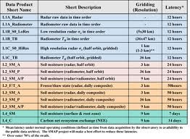
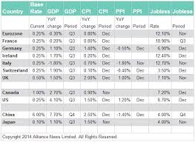
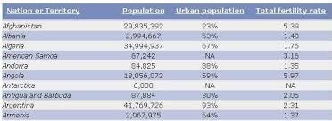
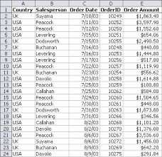
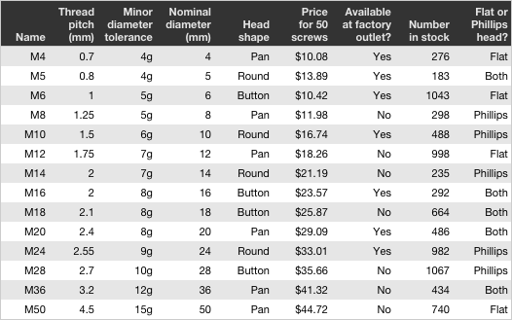
Phase 1 & 2: Business and Data Understanding
Data Mining Task
Data
Classification
Regression
Similarity matching
Clustering
Profiling
Link prediction
…
Identify the data mining task and the data for this task
Notes:
data scientist connects the business side with the technical side

Slide 34
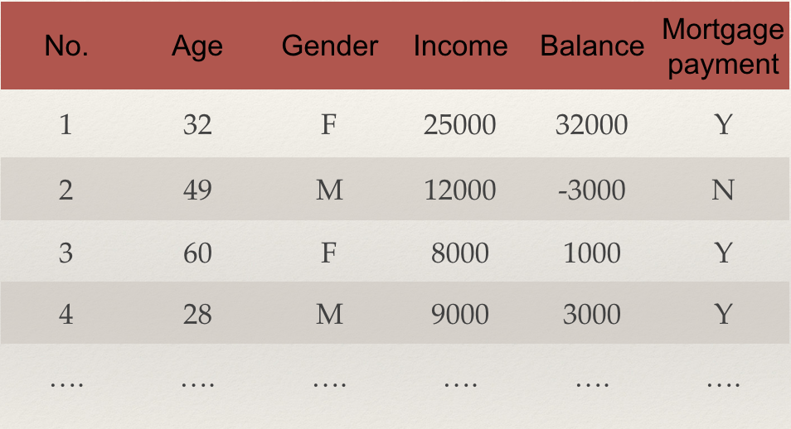
Phase 3: Data Preparation
Can take over 90% of the time!
covers all activities to construct the final dataset (data that will be fed into the modeling tool(s)) from the initial raw data
Include
selection
consolidation
cleaning
transformation
construction
Raw Data
data preparation
Notes:
Illusion: 90%, for some data scientists, that’s 100%
Data mining models impose certain requirements on the data they use. They often require data to be in a form different from how the data are provided naturally, and some conversion will be necessary. Therefore a data preparation phase often proceeds along with data understanding, in which the data are manipulated and converted into forms that yield better results

Slide 35
Phase 3: Data Preparation
Selection
Data
Select attributes
select records
Notes:
records: for example, for data recency, I will only use data in the last 5 years

Slide 36
Phase 3: Data Preparation
Consolidation
actors/actress features
Data
movie cast feature
Person ID
movie features
Movie ID
Person ID
Person ID
Movie ID
Notes:
records: for example, for data recency, I will only use data in the last 5 years

Slide 37
Phase 3: Data Preparation
Be aware of data leakage!
Occurs when a variable collected in historical data gives information on the target variable - information that appears in historical data but is not actually available when the decision has to be made
Example: predicting the revenue of a movie using feature “if won an Oscar”
What x variables do I need to know at the time of the decision
Notes:
categorical: A categorical variable (sometimes called a nominal variable) is one that has two or more categories, but there is no intrinsic ordering to the categories.
ordinal: (clear ordering) ranked categorical
Groupon example: predict whether a customer will be a big spender; knowing the categories of the items purchased are very predictive, but are not known at decision-making time.

Slide 38
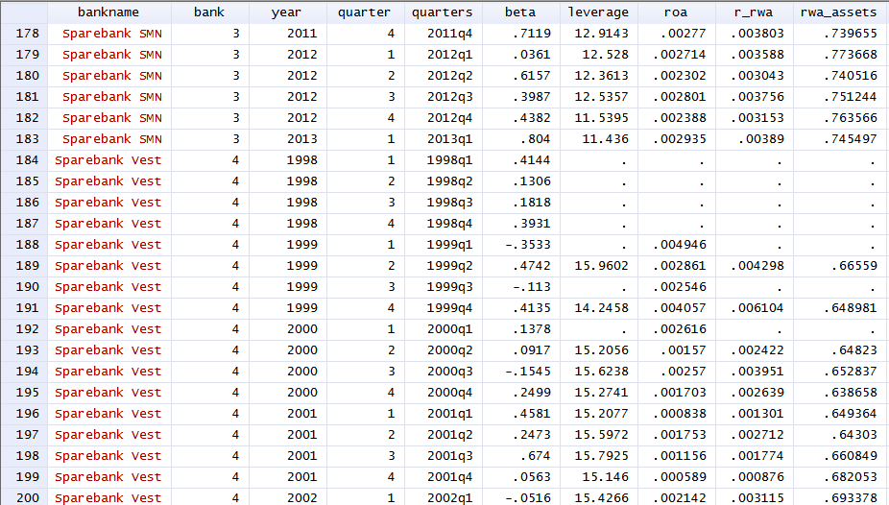
Phase 3: Data Preparation
Consolidation
one big data table
Notes:
each row represents one example.
For supervised, we need Y

Slide 39
Phase 3: Data Preparation
Cleaning (We will talk more about this when introducing Rattle)
bad value: remove (e.g., height = 10 feet, age = 205, etc)
missing value: encode or remove or infer
missing value is a very common and important cleaning step
almost all data sets contain some missing values
In Rattle, you can replace with mean/mode for missing value imputation
Why is the data missing, should it be missing?
Notes:
missing value:

Slide 40
Phase 3: Data Preparation
Transformation (non linear fashion, just adding isn’t)
primarily syntactic modifications made to the data that do not change its meaning, but might be required by the modeling tool
e.g., normalizing continuous data, binary coding categorical data
Construction
Create/derive new features
E.g.: mean, std, multiplication of two attributes, X1 * X2, X1²
BMI is an example-transformation of two quantities
Notes:
normalized is always between 0 and 1

Slide 41

Phase 3: Data Preparation
Data Mining Task
Data
Classification
Regression
Similarity matching
Clustering
Profiling
Link prediction
…
data preparation
Decision tree
svm
logistic regression
new?…
Notes:
Illusion:
spend 90%, for some data scientists, that’s 100%

Slide 42
Phase 4: Modeling
Selecting modeling techniques and calibrating their parameters
Typically, there are several techniques for the same data mining problem type
later in the course: decision trees, logistic regression, svm, etc
Generate test design
to test the model’s quality and validity
eg: classification
Notes:
The primary place where data mining techniques are applied to the data

Slide 43
Phase 5: Evaluation
Review process
Evaluate performance
How well does the model perform? (from data mining point of view)
How well does the model meet business needs? (from business point of view)
Notes:
assess the data mining results rigorously and to gain confidence that they are said and reliable before moving on.
recall that the primary goal of data science for business is to support decision making, and that we started the process by focusing on the business problem we would like to solve. Usually a data mining solution is only a piece of the larger solution.;
Asymmetric cost-false positives for cancer? Or true negative for cancer?

Slide 44
Phase 5: Evaluation
choose the right evaluation metric
e.g., accuracy with classification models, mean error rate with regression models
application specific metric
Example: spam detection
A spam detection model may be extremely accurate
Evaluation shows that it produces too many false alarms
What is the cost of dealing with false alarms?
Notes:
recall that the primary goal of data science for business is to support decision making, and that we started the process by focusing on the business problem we would like to solve. Usually a data mining solution is only a piece of the larger solution.;
A spam detection model may be extremely accurate

Slide 45
Phase 6: Deployment
Determine how the results need to be utilized
Who needs to use them?
How often do they need to be used?
The knowledge gained will need to be organized and presented in a way that the customer can use it. Depending on the requirements, the deployment phase can be as simple as generating a report or as complex as implementing a repeatable data mining process across the enterprise
Example:
fraud detection model
hospital admission
Notes:
Deploy a model or result?
if it’s a model, it usually require that the model be recoded of the production environment, usually for greater speed or compatibility with an existing system, this may incur substantial expense and investment. In many cases, the data science team is responsible for producing a working prototype and its evaluation and then pass these to an evaluation team; asking for computing resources, do parallelization
Sometimes needs to be recoded for the production environment for greater speed or compatibility with an existing system
hospital: some deployment an also be much less technical
returns to business understanding phase. the process of dm produces a great deal of insight into the business problem and the difficulties of its solution. A second iteration can yield an improved solution. experience of thinking about the business, the data, and the performance, and even new lines of business or new ventures.
you don’t have to wait till deployment to start the process again.

Slide 46
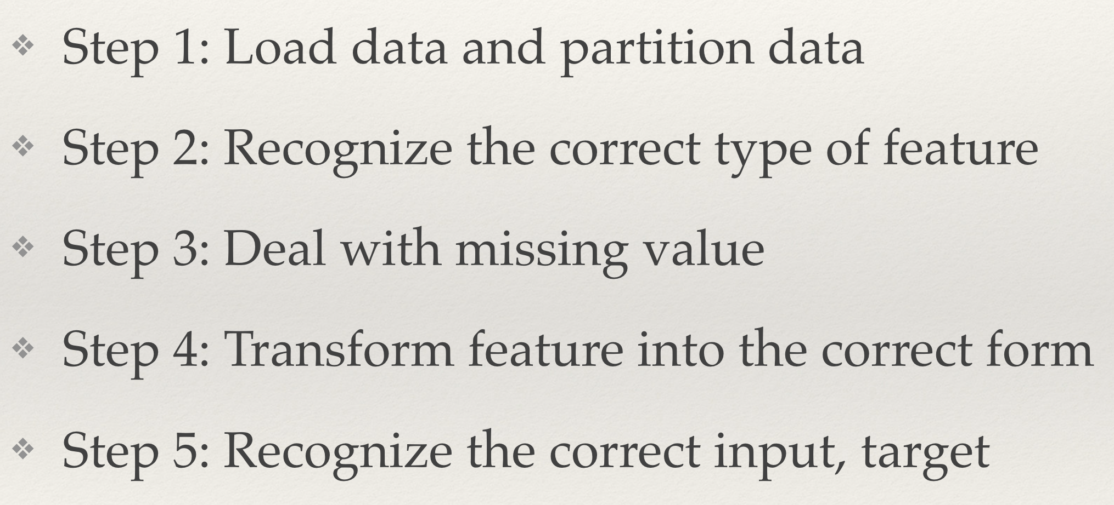
Data Mining Task
Database
Classification
Regression
Clustering
Profiling
Link Prediction
…
Data exploration & Visualization
Can be done on Rattle

Slide 47

Demo Datasets
Dataset 1: 150 iris flowers of types Iris Setosa, Iris Versicolor, Iris Virginia.
Attributes: Sepal length,Sepal Widths,Petal lengths, Petal widths (all continuous)
Target: name of the flower type
Dataset 2: weather
Attributes: temperature, rainfall, wind, etc
Target: Rain tomorrow?

Slide 48
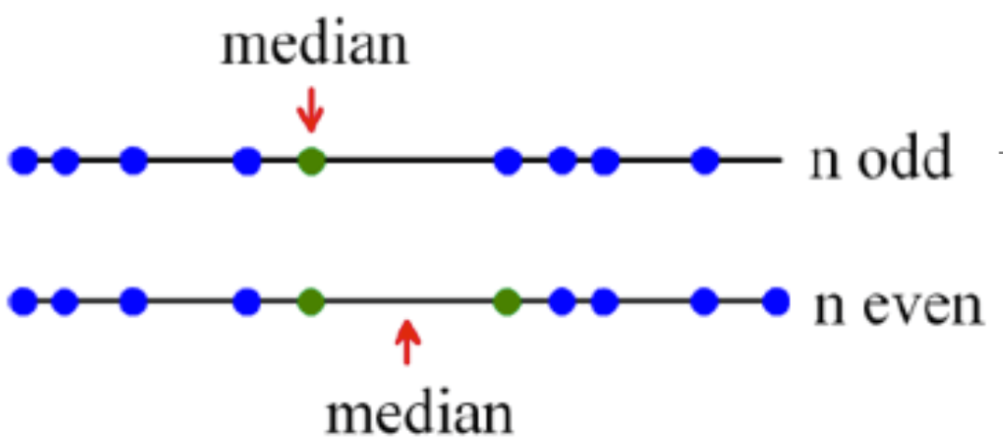
Reminder: median, quantiles, quartiles, interquartile range
Median: the value in the middle (for the values given in increasing order)
q% - quantile (0<=q<=100): The value for which q% of the values are smaller and 100-q% are larger. The median is the 50% quantile
Quartiles: 25%-quartile (1st), median (2nd), 75%-quantile (3rd)
Interquartile range: 3rd quantile - 1st quantile (the middle half)
Notes:
a slide that Mike can use

Slide 49
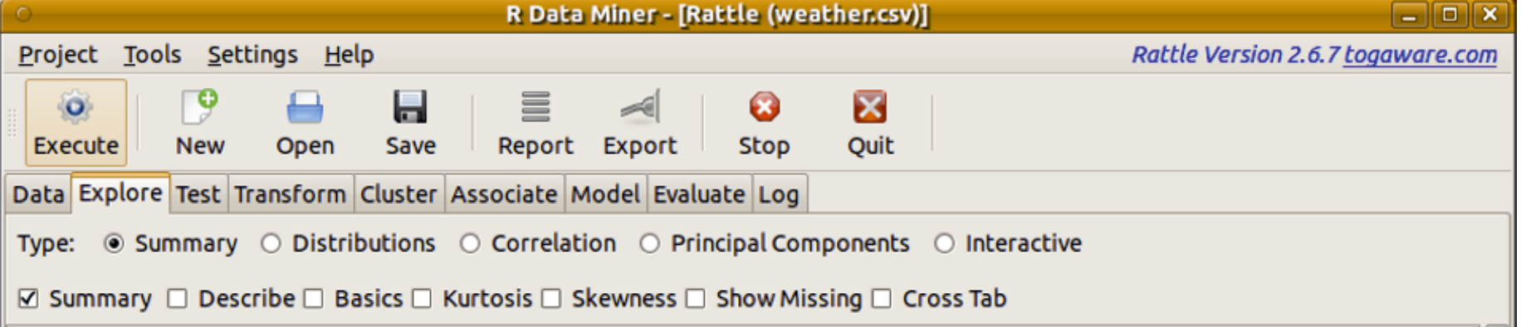
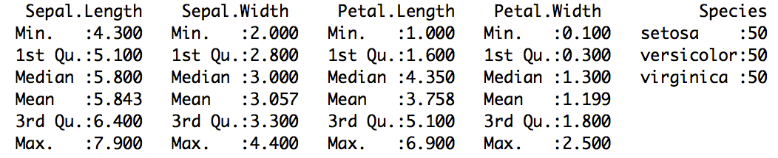
Exploring Data - summary
2.
1.
q% - quantile (0<=q<=100): The value for which q% of the values are smaller and 100-q% are larger. 1st Quartile = 25% quantile

Slide 50
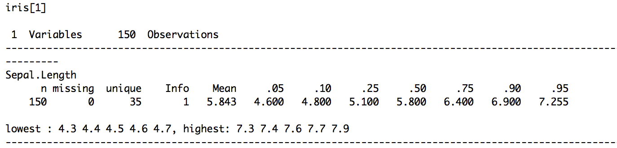
Exploring Data - describe
Notes:
describe() provides a more detailed summary

Slide 51
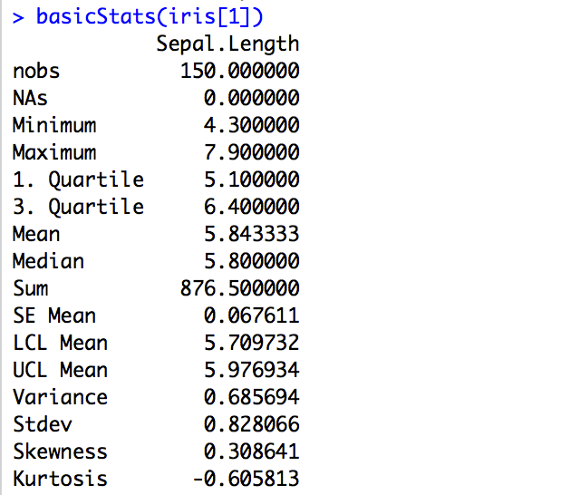
Exploring Data - basics
Notes:
basicStats() provides a even more detailed summary of the numeric data

Slide 52
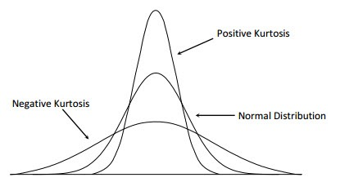
Exploring Data - kurtosis
Kurtosis is a measure of “tailedness”.
A useful measure of whether there is a problem with outliers in a data set. Larger kurtosis indicates a more serious outlier problem
Kurtosis of any univariate normal distribution is 3.
Low Kurtosis
High Kurtosis
Notes:
basicStats() provides a even more detailed summary of the numeric data

Slide 53
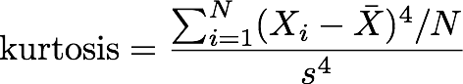
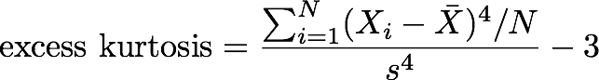
Exploring Data - kurtosis
For univariate data X1, X2, …, XN
where is the mean, s is the standard deviation, and N is the number of data points.
The kurtosis for a standard normal distribution is 3. For this reason, some sources use the following definition of kurtosis (referred to as “excess kurtosis”)
Notes:
normal distribution is the benchmark

Slide 54
Exploring Data - skewness
A measure of asymmetry. It indicates whether there is a long tail on one or the other side of the mean value of the data.
A skewness of magnitude (i.e., ignoring whether it is positive or negative) greater than 1 represents quite an obvious extended spread of the data in one direction or the other.
A positive skewness indicates that the spread is more to the right side of the mean (i.e., above the mean). A negative skewness is the same but on the left side.
Notes:
basicStats() provides a even more detailed summary of the numeric data

Slide 55
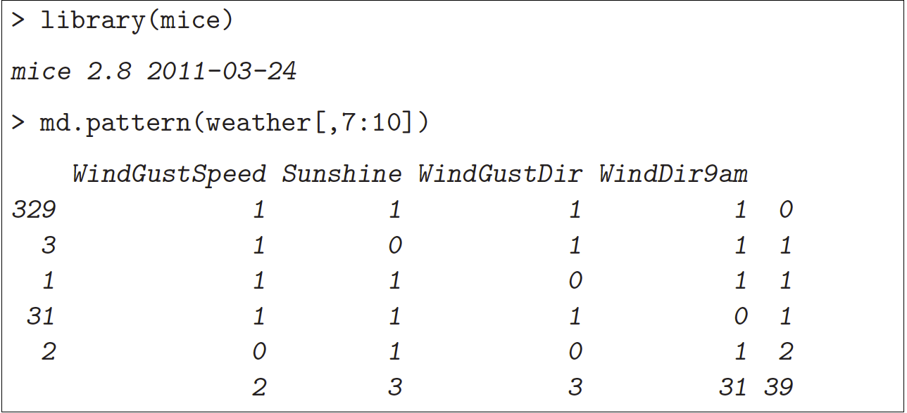
Exploring Data - missing data
# of rows
data pattern
# of missing entries
Notes:
The left column records the number of observations that match the
corresponding pattern of missing values. There are 329 observations
with no missing values over these four variables (each having a value of
1 within that row). The nal column is the number of missing values
within the pattern.

Slide 56
Data Visualization
For numerical attributes:
A Single features
Box Plot
Histogram
A pair of features
Scatter Plot
For categorical attributes:
A Single feature
Bar Plot
Dot Plot
A pari of features
Mosaic Plot
Correlation Analysis

Slide 57
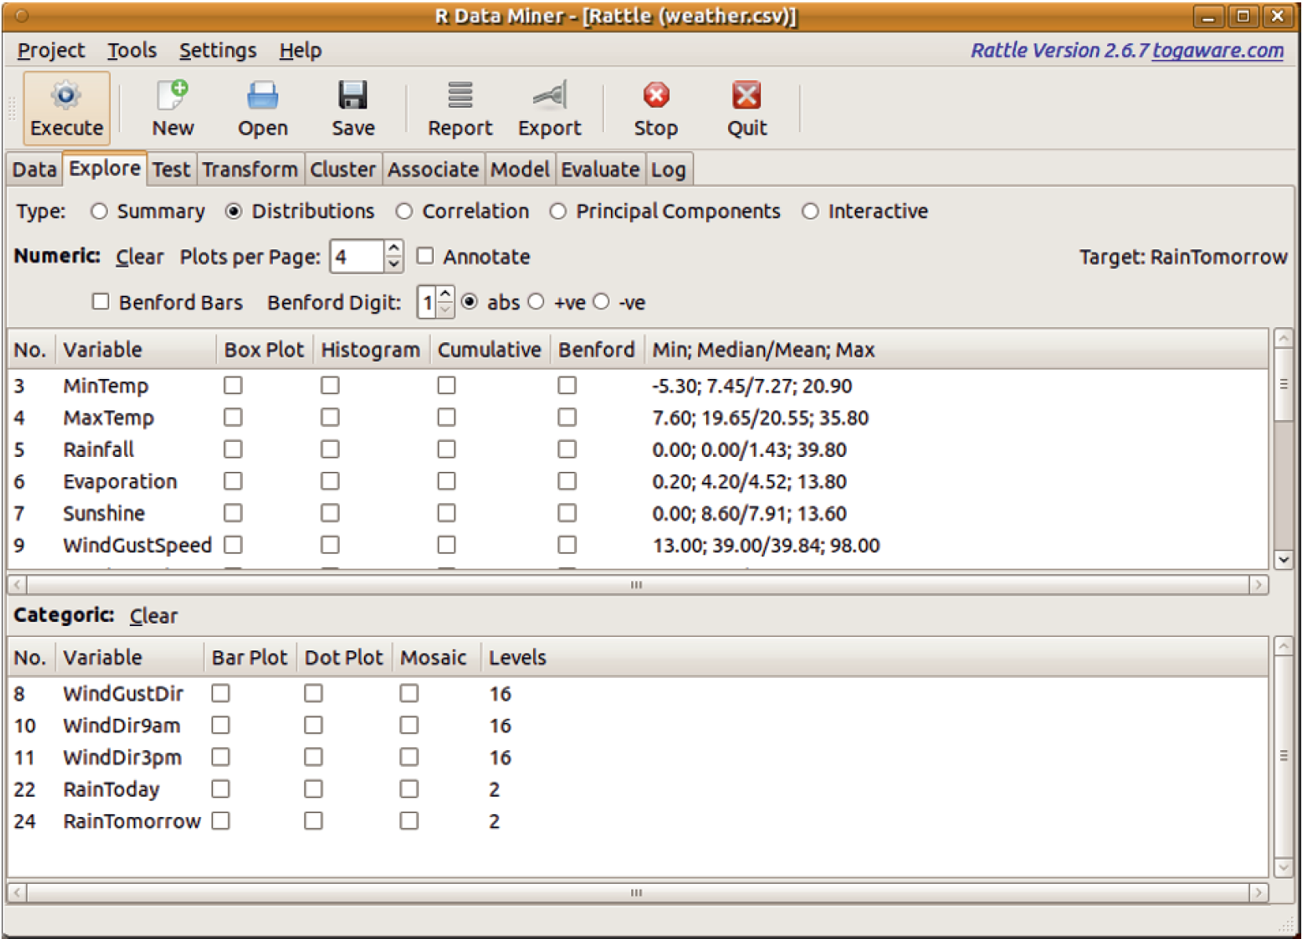
Visualizing Distribution

Slide 58
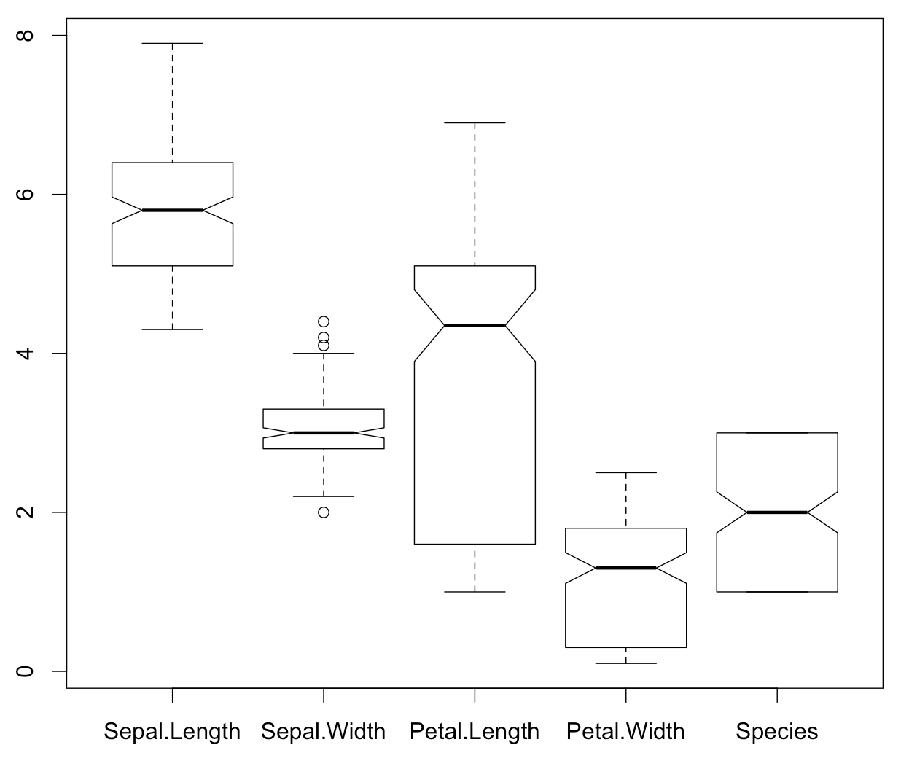
Box Plot
A box plot provides a graphical overview of how the observations of a variable are distributed.
Dashed lines extend to the maximum and minimum data points, which are no more than 1.5 times the interquartile range from the median.
Outliers (points further than 1:5 times the interquartile range from the median) are then individually plotted.
notch: 95% confidence interval of median
maximum
upper whisker
outliers
Q3 (75%)
median (50%)
Q1 (25%)
lower whisker
minimum
Notes:
Which one has a sharper peak?

Slide 59
Visualizing Distribution

Slide 60
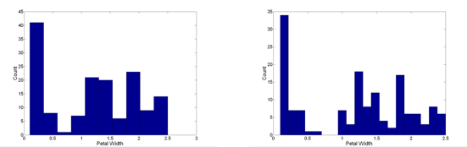
Histogram
Histogram
Usually shows the distribution of values of a single variable
Divide the values into bins and show a bar plot of the number of objects in each bin.
The height of each bar indicates the number of objects
Shape of histogram depends on the number of bins
Example: Petal Width (10 and 20 bins, respectively)
Frequency
Attribute Value
Notes:
The number of bins is very important

Slide 61
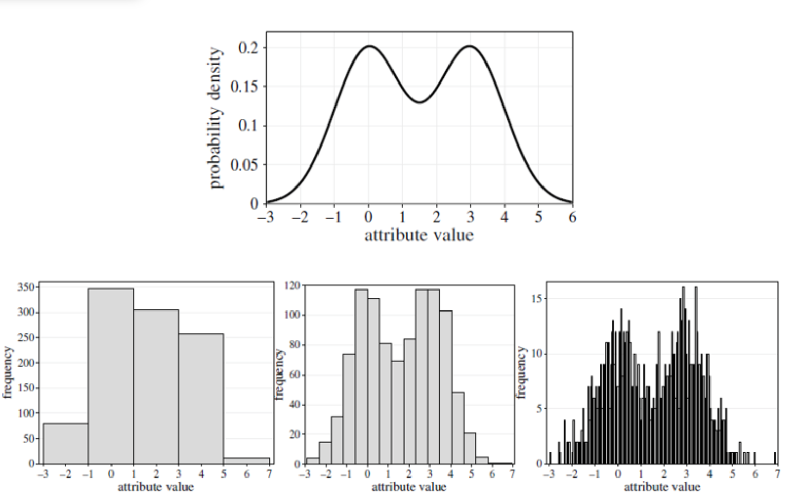
Histogram

Slide 62
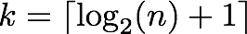
Histogram
A rule of thumb for the determination of the “correct” number of bins is Sturge’s rule:
where n is the sample size

Slide 63
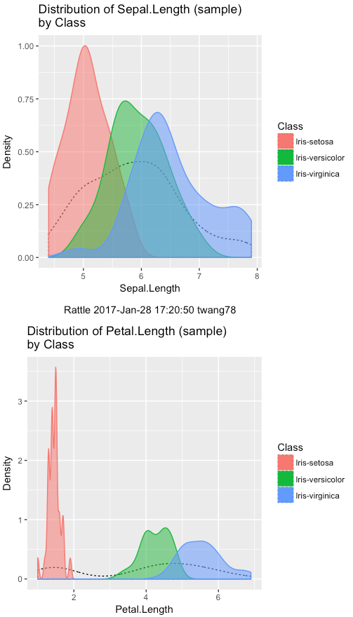

Slide 64
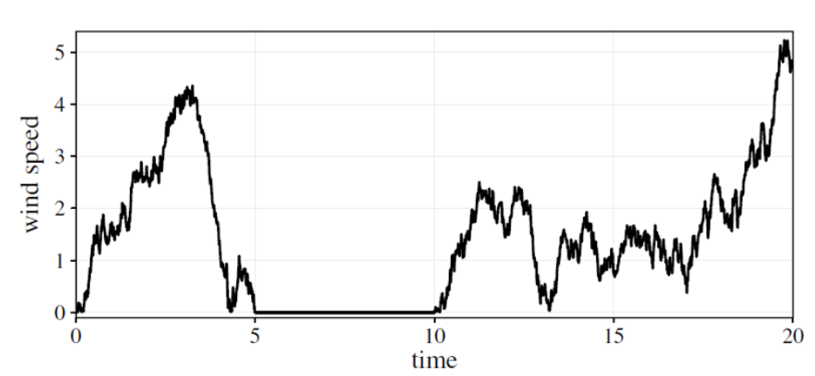
Hidden missing values
The zero values might result from a broken or blocked sensor and might be considered as missing values
Notes:
House breaks data

Slide 65
What do you do with an Outlier?
Outliers represent a managerial problem or opportunity - or an error in data entry
Was the value entered into the computer correctly? If there was an error in data entry, fix it.
Was it due to chance? then you should keep the value in your analyses. The value came from the same population as the other values, so should be included.
Was it due to a mistake like bad data collection? remove it (note: removal of data points should not be taken lightly and should be noted in the footnotes of your report.)

Slide 66
Scatter Plots
Scatter plots
Attributes values determine the position
Two-dimensional scatter plots most common, but can have three-dimensional scatter plots
Often additional attributes can be displayed by using the size, shape, and color of the markers that represent the objects
It is useful to have arrays of scatter plots can compactly summarize the relationships of several pairs of attributes

Slide 67
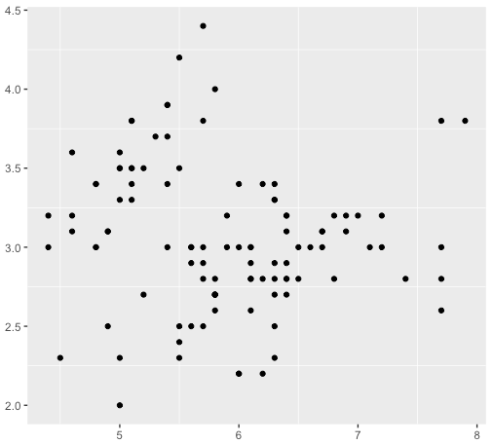
Scatter Plot
Sepal Width
Sepal Length

Slide 68
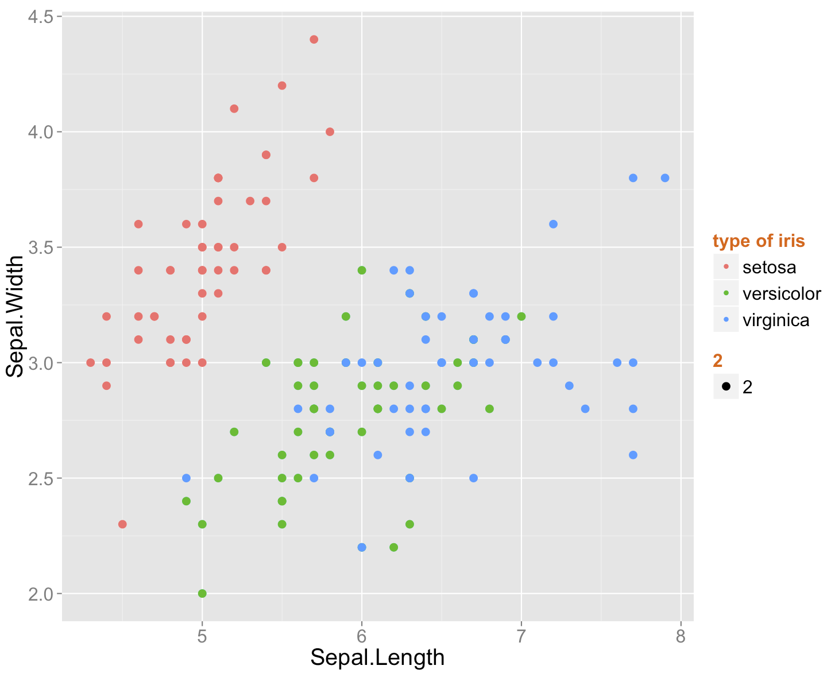
Scatter Plot with additional information from a third attribute
Scatter plots can be enriched with additional information: color of different symbols incorporating a third attribute in the scatter plot
Can you distinguish the three types of flowers from each other using attributes Sepal.Width and Sepal.Length?

Slide 69
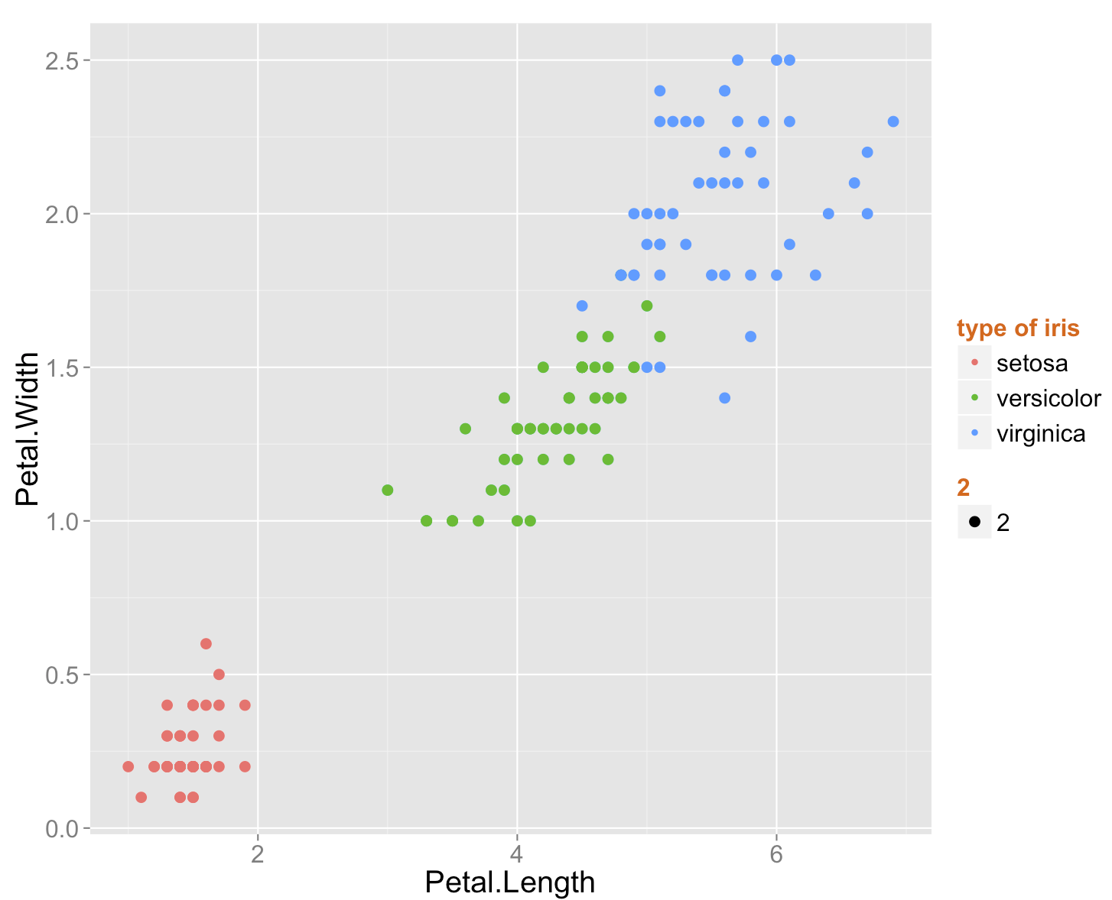
Scatter Plot with additional information from a third attribute
Notes:
ggplot(iris0, aes(x = Sepal.Length, y = Sepal.Width,color = factor(Species),size = 2,label = Species)) + geom_point() + theme(legend.title = element_text(color = "chocolate",size = 16,face = "bold"),text = element_text(size=20)) + scale_color_discrete(name = "type of iris")

Slide 70
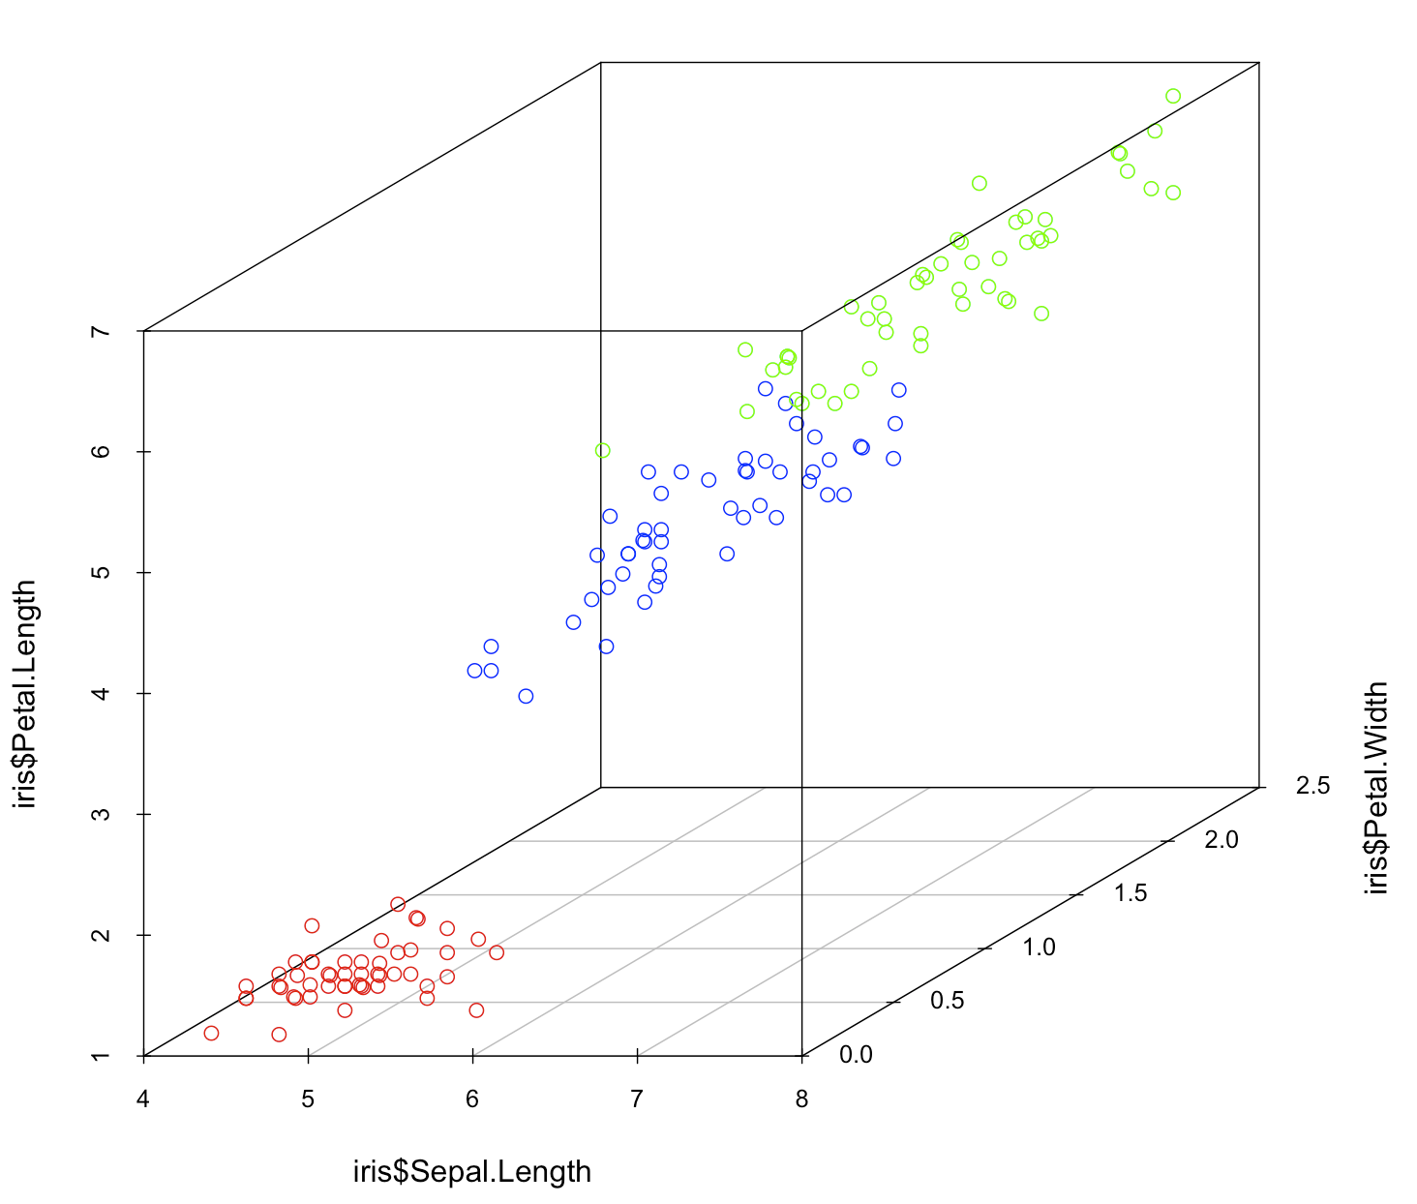
3D Scatter Plot

Slide 71
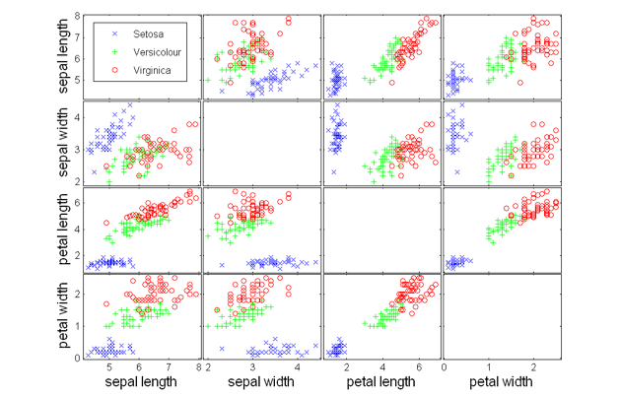
Array of scatter plots

Slide 72
Data Visualization
For numerical attributes:
Box Plot
Histogram
Scatter Plot
For categorical attributes:
Bar Plot
Dot Plot
Mosaic Plot
Correlation Analysis

Slide 73
Visualizing Distribution

Slide 74
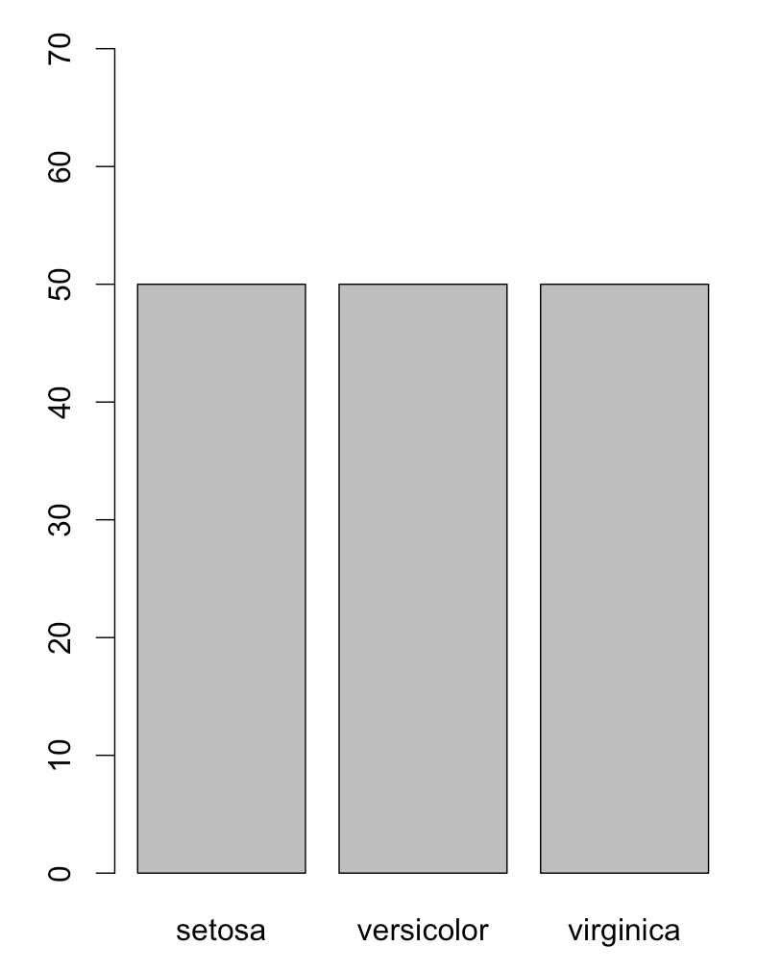
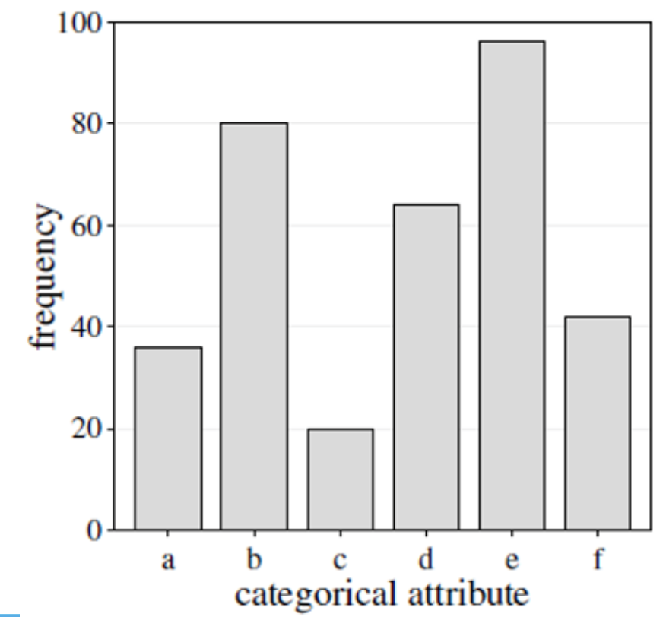
Bar Plot
For categorical attributes
A bar plot is a simple way to depict the frequencies of the values of a categorical attribute
Similar to histogram
Frequency
Attribute Value
Notes:
A bar plot, much like a histogram, uses vertical bars to show counts of
the number of observations of each of the possible values of the categoric variable. There are many ways to graph a bar plot. In Rattle, the default
is to list the possible values along the x-axis, leaving the y-axis for the
frequency or count

Slide 75
Visualizing Distribution

Slide 76
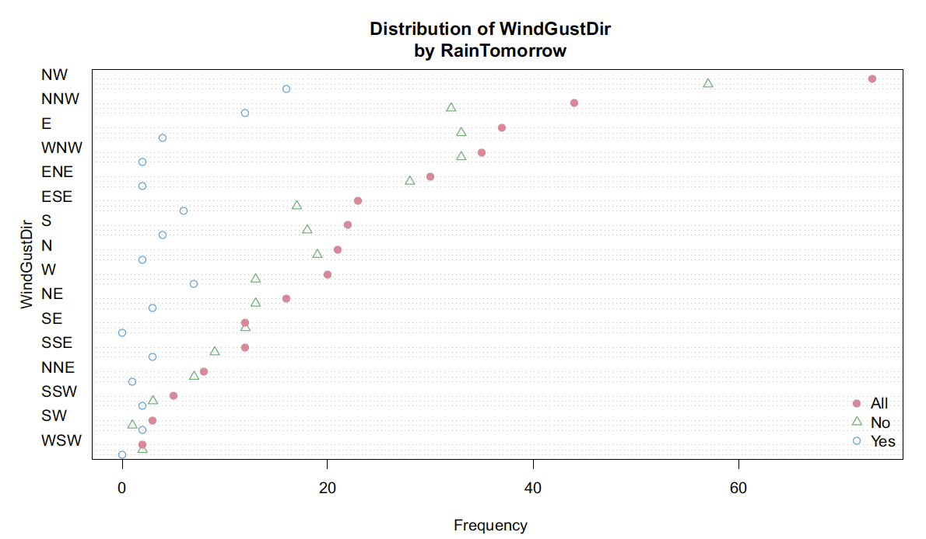
Dot Plot
A dot plot illustrates much the same information as a bar plot but uses dots to show the height.
Notes:
By default in Rattle the plots are horizontal rather than vertical.
dot plots and bar plots are interchangeable. It’s up to you which one to use.

Slide 77
Visualizing Distribution

Slide 78
Mosaic Plot
to visualize the distribution of the values of one variable (v1) over the different values of another variable (v2), looking for any structure or relationship between those variables
v1 and v2 are categorical.
In Rattle, v2 is usually the target variable.
Notes:
The mosaic plot again provides insights into how the data is distributed
over the values of a second variable. The area of each bar is
proportional to the number of observations having a particular value
for the variable WindGustDir.

Slide 79
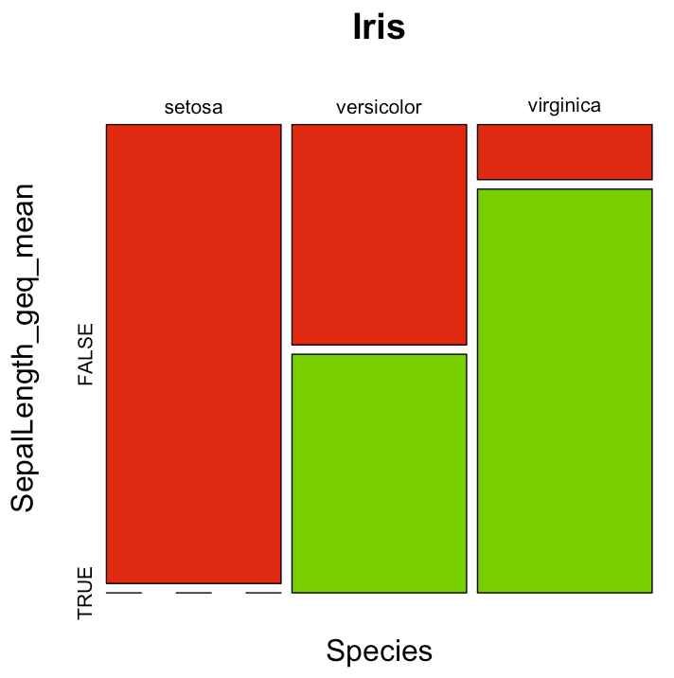
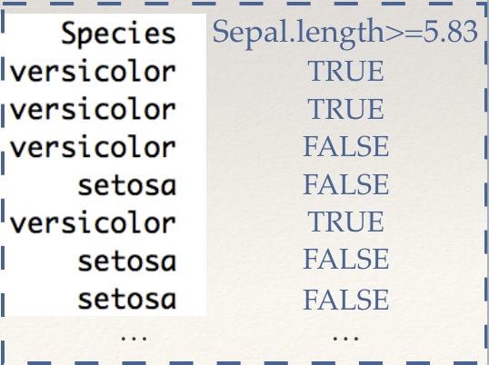
Mosaic Plot
v1
v2
v1
v2
Notes:
Draw on board
Education vs Income>50k
Gender vs Income>50k

Slide 80
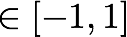
Correlation Analysis
A correlation coefficient is a measure of the degree of relationship between two variables,
The magnitude represents the strength of the correlation and the sign represents the direction of the correlation.

Slide 81
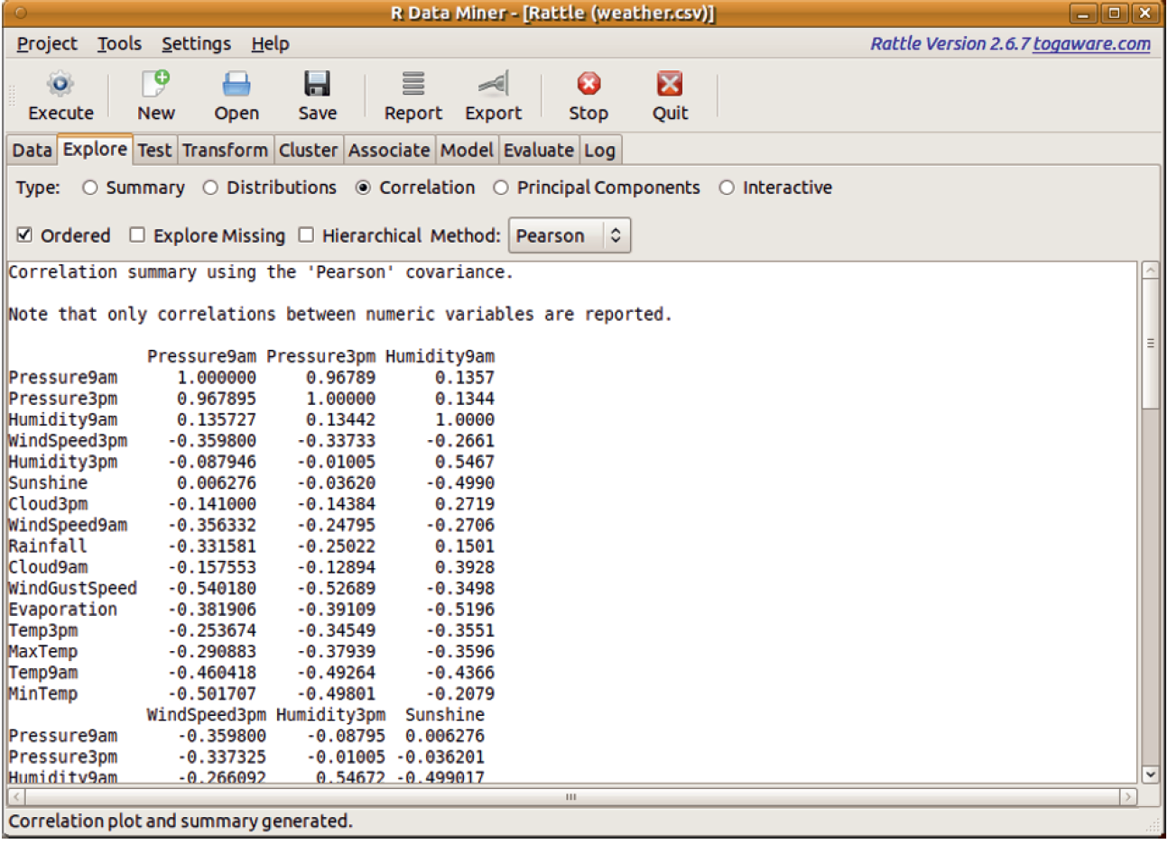
Correlation Analysis

Slide 82
Correlation Analysis
Which pair of features shows a high positive correlation?

Slide 83
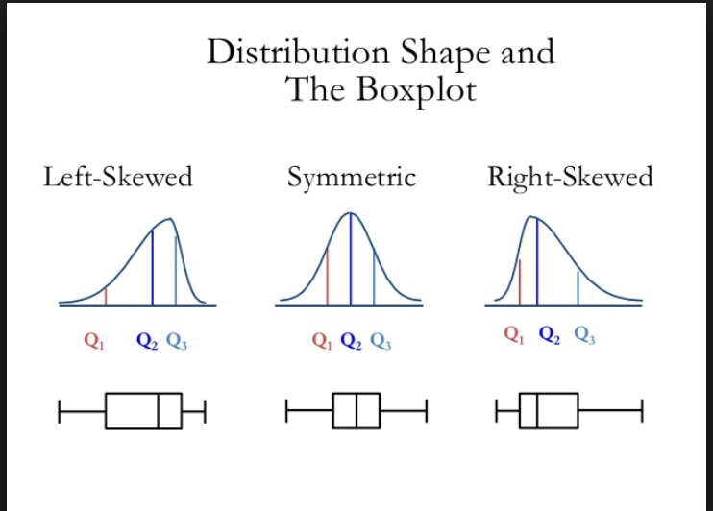



Practice
Assuming the boxplot was generated from one of the two distributions. Which one should it be? Briefly explain your answer.
A
B

Slide 84
Practice on Rattle
Features
1. Has been pregnant before ( 0, 1)
2. Plasma glucose concentration a 2 hours in an oral glucose tolerance test
3. Diastolic blood pressure (mm Hg)
4. Triceps skin fold thickness (mm)
5. 2-Hour serum insulin (mu U/ml)
6. BMI>= 32 (0,1)
7. Diabetes pedigree function
8. Age (years)
Class variable
Y (0 or 1)

